Slide 1
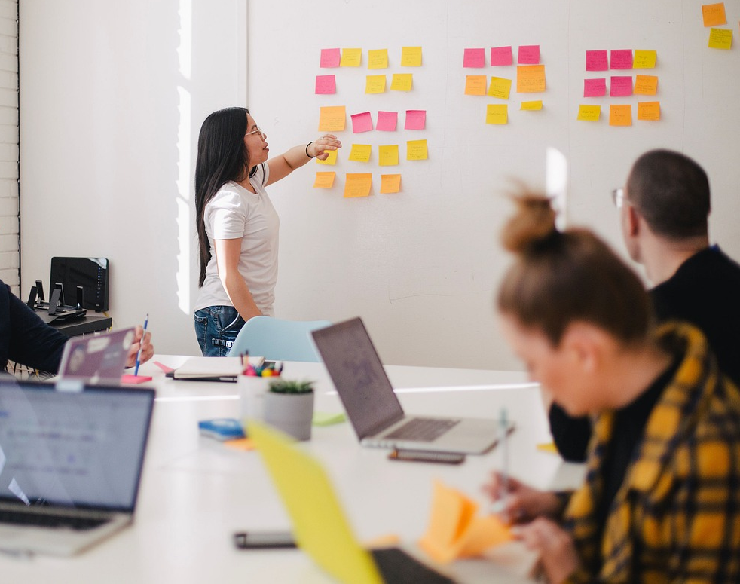

Groups and meetings
SESSION VI: GROUPS & TEAMS (IN) ACTION

Slide 2

Chapter outlines
What is a meeting?
PRE-meeting
Components of agenda
POST-meeting communication – meeting minute / follow up
Using Technology

Slide 3
LEARNING OBJECTIVES
By the end of this section, you will be able to:
Discuss how to prepare for group meetings
Identify strategies for effectively facilitating meetings
Understand how to use technology to aid in group communications

Slide 4
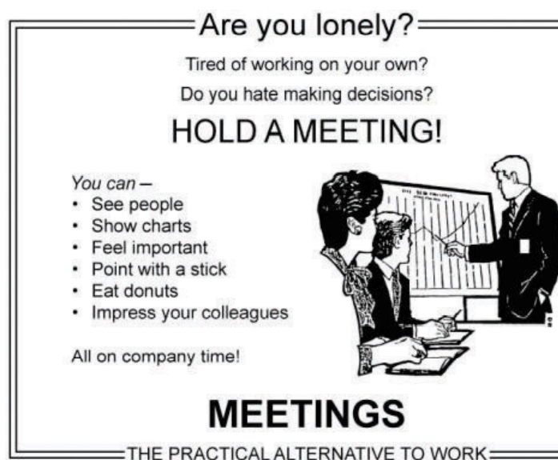
1. What is a meeting?
Meetings are a part of how groups get work done.
Some view meetings as boring, pointless, and futile exercises
Some see them as opportunities to exchange information and produce results.

Slide 5

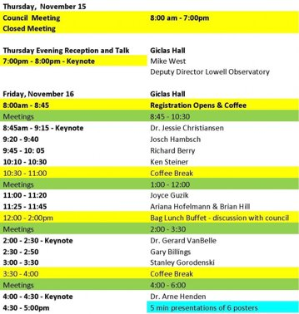
2. PRE-meeting
Needs a clear purpose statement
Plan meeting schedule

Slide 6
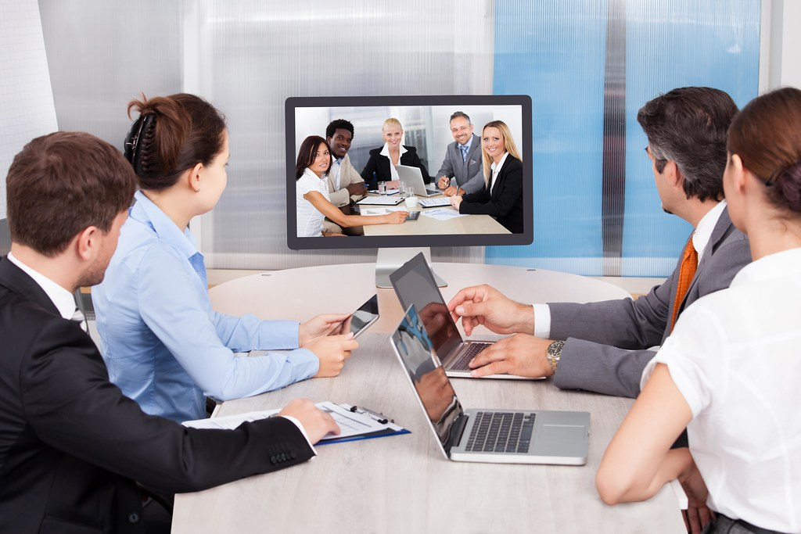
DECIDING HOW TO MEET
Meeting in person: Need to decide how and where to meet.
Virtual meetings: Use some of the technologies

Slide 7

Discussion
Identify the strengths and weaknesses of face-to-face meetings?
List types of effective application technologies for meetings?

Slide 8
FORMULATING AN AGENDA
Agenda
The outline of items to be discussed and tasks to be accomplished during a meeting.

Slide 9
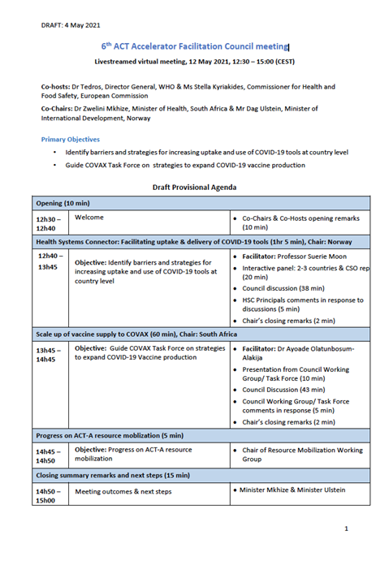
3. Components of agenda
Purpose of Meeting
A list of points to be considered, and a brief summary of relevant information that relates to each point.
List of participants
Date
Time
Place

Slide 10
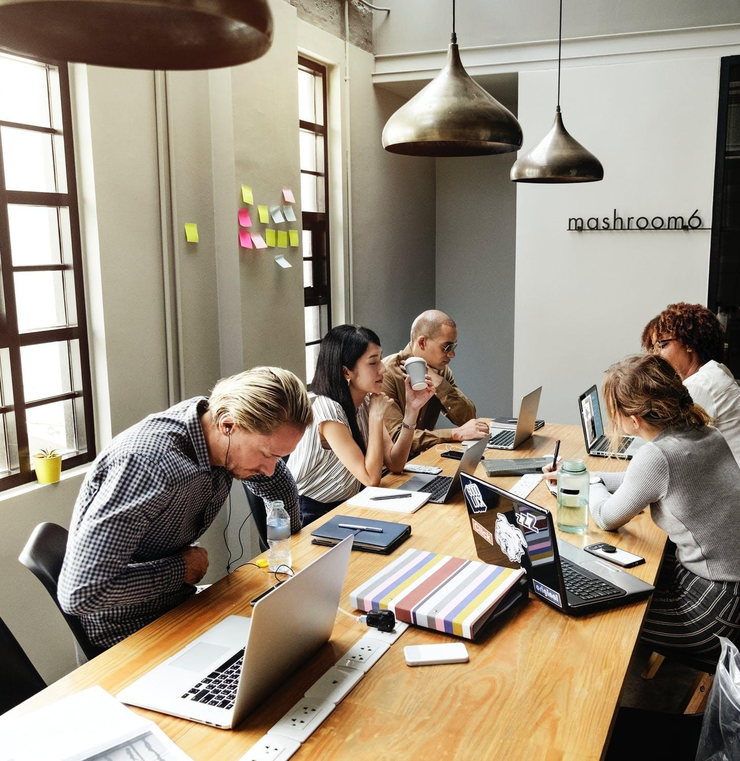
INVITING MEETING PARTICIPANTS
Adding additional participants for no clear reason will only make the process more complex and may produce negative results.
Inviting the participants via e-mail has become increasingly common across business and industry.
Software programs like Microsoft Outlook allow you to initiate a meeting request and receive an “accept” or “decline” response that makes the invitation process organized and straightforward.
A reminder email on the day of the meeting, often early in the morning, can serve as a personal effort to highlight the activities of the day.

Slide 11

IDENTIFYING AN APPROPRIATE MEETING SPACE
A table that is square, rectangular, or U-shaped
Tables that are round, or tables arranged in a circular pattern, allow for a more egalitarian model of interaction, reducing the hierarchical aspects while reinforcing the clear line of sight among all participants.

Slide 12
MEETING CHECKLIST FOR PARTICIPANTS
Mary Ellen Guffey (2007) provides a useful participant checklist that is adapted here for our use:
Arrive on time and stay until the meeting adjourns (unless there are prior arrangements)
Leave the meeting only for established breaks or emergencies
Be prepared and have everything you need on hand
Turn off cell phones and personal digital assistants
Follow the established protocol for turn taking
Respect time limits
Demonstrate professionalism in your verbal and nonverbal interactions
Communicate interest and stay engaged in the discussion
Avoid tangents and side discussions
Respect space and don’t place your notebook or papers all around you
Clean up after yourself
Engage in polite conversation after the conclusion

Slide 13
Perils of Poor Facilitation
An argument starts about an established fact.
Opinions are introduced as if they were truths.
People intimidate others with real or imaginary “knowledge.”
People overwhelm each other with too many proposals for the time available to consider them.
People become angry for no good reason.
People promote their own visions at the expense of everyone else’s.
People demand or offer much more information than is needed.
Discussion becomes circular; people repeat themselves without making any progress toward conclusions.

Slide 14
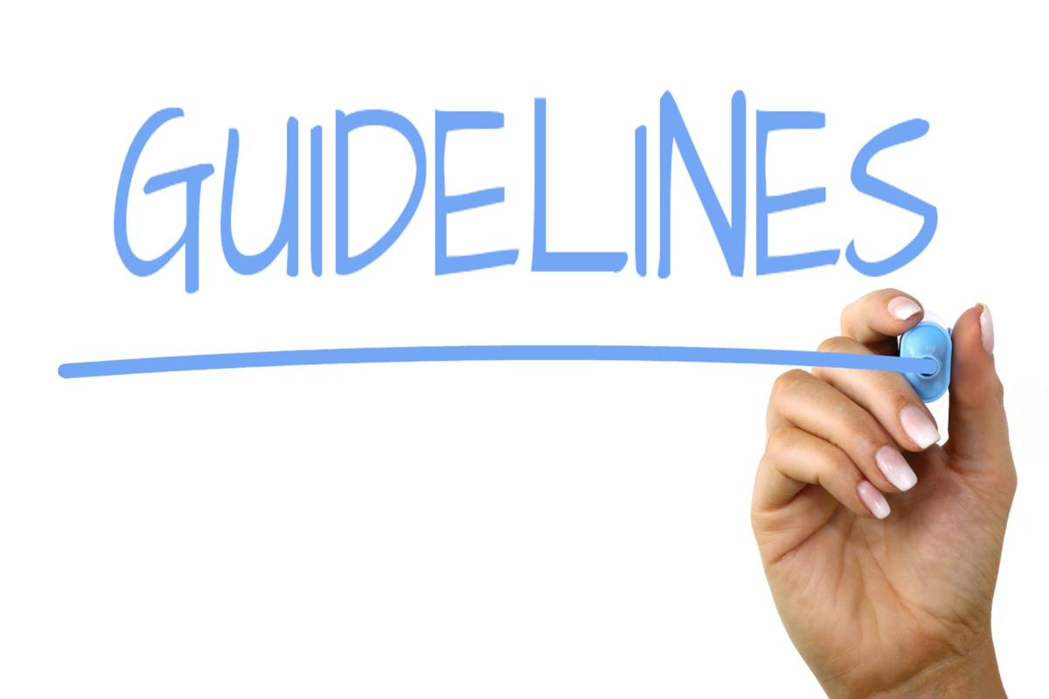
Guidelines for Facilitating a Meeting
Start promptly
Begin with something positive
Tend to housekeeping details
Make sure people understand their roles
Keep to your agenda
Guide, don’t dictate
Keep your eyes open for nonverbal communication
Capture and assign action items

Slide 15
Guidelines for Facilitating a Meeting
9. Make things fun and healthy
10. Avoid sarcasm and cynicism.
11. Take breaks regularly, even when you think you don’t need them
12. Show respect for everyone
13. Expect the unexpected
14. Conduct multiple assessments of the meeting. Formative assessment
15. Think (and talk) ahead

Slide 16
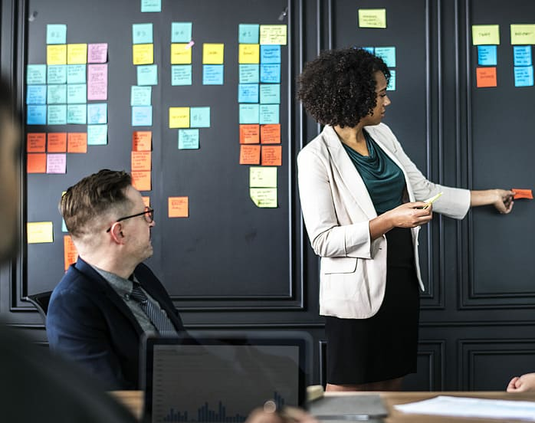
4. POST-Meeting Communication
Summarizing what has been discussed or decided, and what actions the group members are to take as a result of the meeting.
Finalize the minutes of the meeting: notes in relation to actions taken during the meeting or specific indications of who is responsible for what before the next meeting.

Slide 17
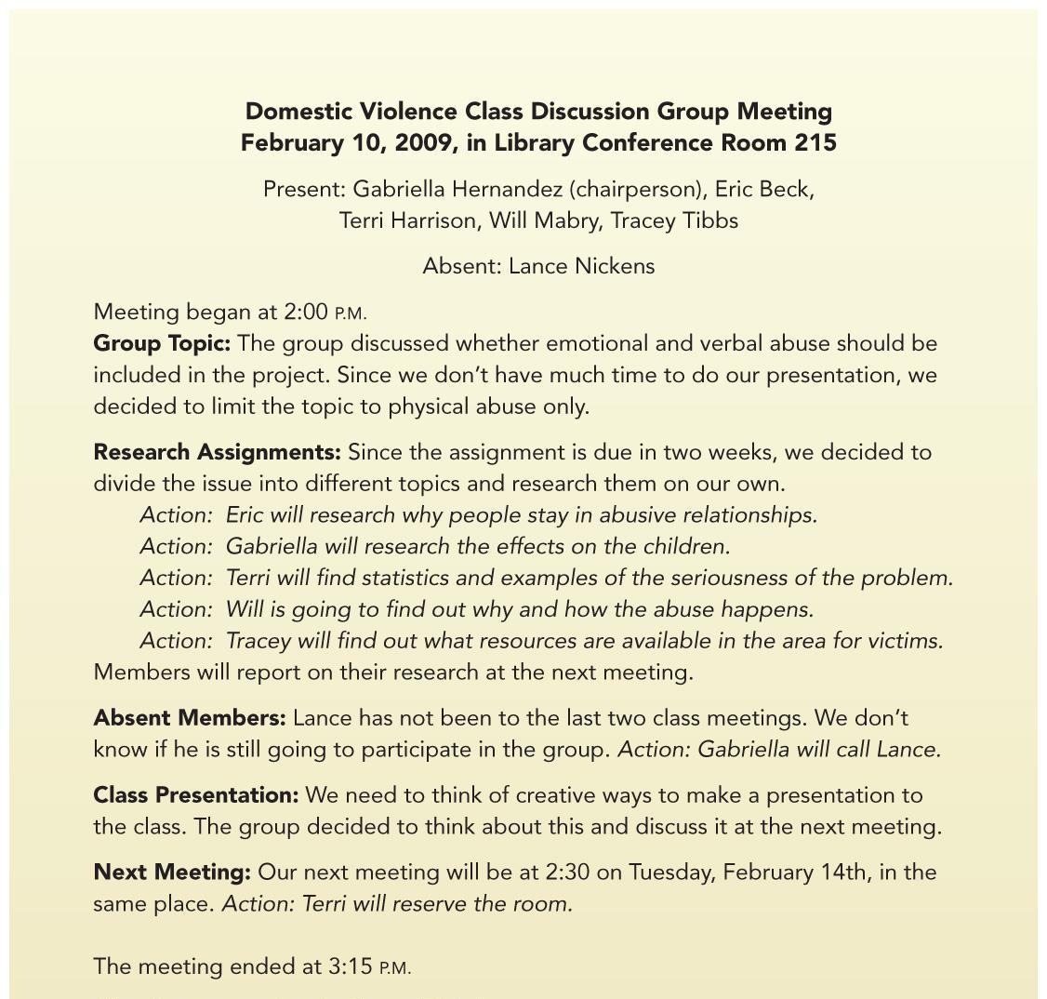
Sample of Informal Minutes

Slide 18

5. Using Technology
Using Technology to Facilitate Meetings
Audio-Only Interactions
Audio-Visual Interactions

Slide 19

TIPS FOR VIRTUAL MEETINGS
1. Get all the participants in an audio meeting to say something brief at the start of the meeting so that everyone becomes familiar with everyone else’s voice.
2. Remind people of the purpose of the meeting and of the key outcome(s) you hope to achieve together.
3. Listen/watch for people who aren’t participating and ask them periodically if they have thoughts or suggestions to add to the discussion.
4. Summarize the status of the meeting from time to time.
5. If you’re holding an audio conference, discourage people from calling in on a cell phone because of potential problems with sound quality.
6. Because you may not have nonverbal cues to refer to, ask other members to clarify their meanings and intentions if you’re not sure their words alone convey all you need to know.
7. If you know you’re going to have to leave a meeting before it ends, inform the organizer in advance. Sign off publicly, but quickly, when you leave rather than just hanging up on the meeting connection.

Slide 20
Review & Reflection Questions
Imagine you are about to meet with your group for the first time. What are key steps you want to consider in preparing for a meeting? What items might you want to include on your first agenda?
Reflect on meetings you have attended in the past. What strategies have you observed facilitators use? What did you find to be effective and ineffective?
How might you use technology to conduct a group meeting? What might be the advantages and disadvantages?

Slide 21
Q&A

